Slide 1
Project 2 : Corn Porduction
Visualizing Spatio-Temporal Climate Impacts on Corn Production and Price

Slide 2
Project Overview
Team Members:
Kkshitij Kapadia
Het Patel
Davo Acevedo Cardona
Muhammed Aamir Naveed

Slide 3
Information about the data
Corn is a critical agricultural daily need .
Understanding the relationship between its market price and environmental factors.
Our project investigates how seasonal and long-term climate variables.
Influence corn prices across the United States.

Slide 4
The dataset
Year | Avg_Temperature | Adjusted_Corn_Price | Total_Precipitation
2010 | 15.66 | 29.47 | 1.69
2011 | 18.23 | 39.88 | 1.26
2012 | 28.27 | 42.10 | 1.00
…… | …… | …… | ……
2024 | 23.11 | 18.56 | 2.86

Slide 5
Question 1:
Seasonal dynamics ( Temperature and Precipitation) affect the stock price

Slide 6
Precipitation v/s Stock price
Temperature v/s Stock price
Precipitation (inches)
Heavy year-round rainfall
Seasonal monsoon-driven precipitation
Light winter snowfall with occasional rain
Very low annual precipitation; arid climate
Temperature (°F)
Hot summers and mild winters
Cold winters and warm, humid summers
Mild temperatures year-round
Severe winters with heavy snowfall
How climatic conditions affect the stock prices ?
What are the fluctuations over the years ?

Slide 7
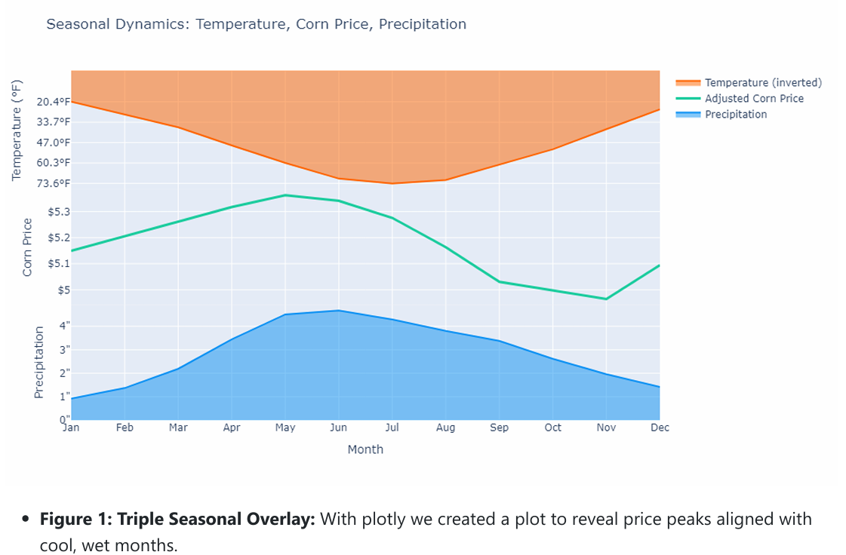

Slide 8
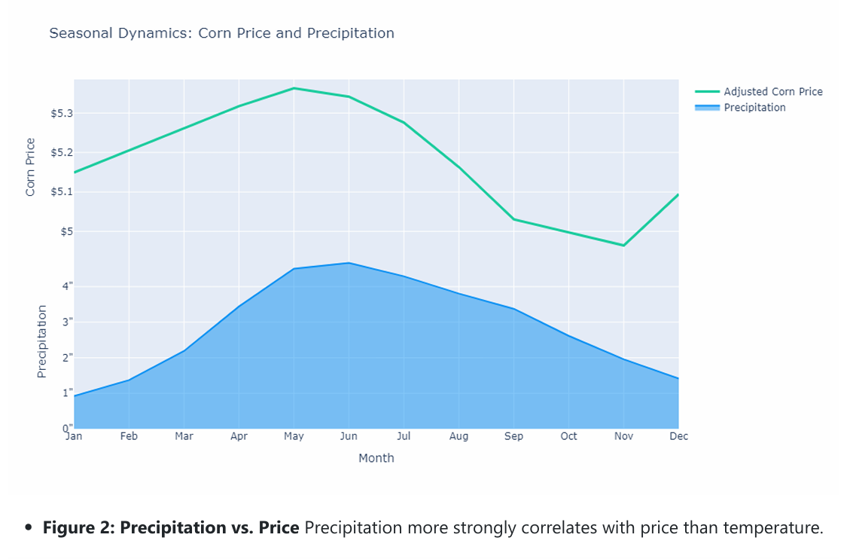

Slide 9
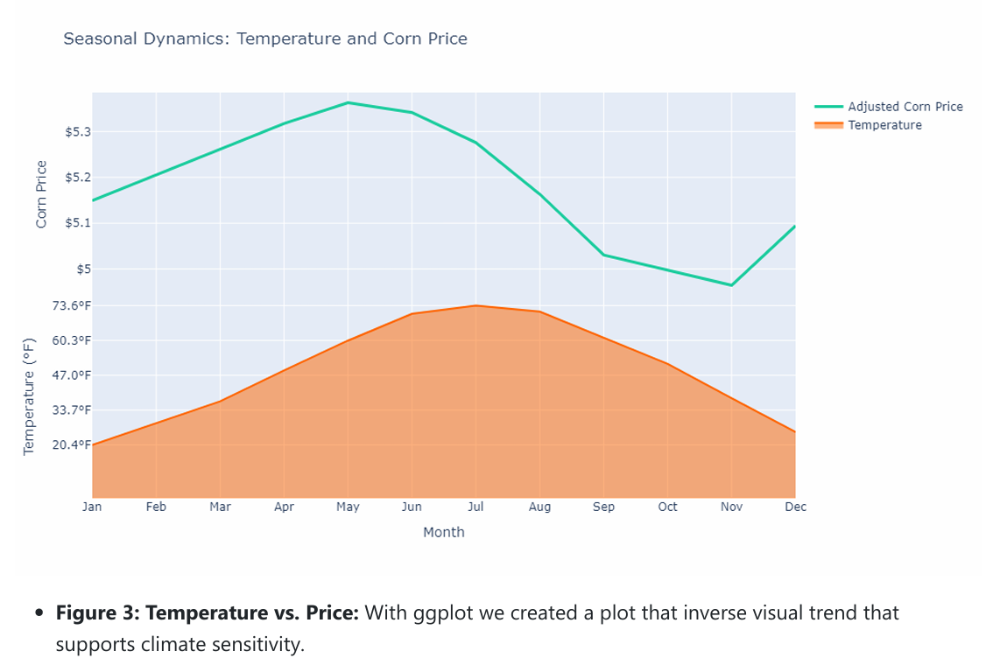

Slide 10
Question 2:
Monthly breakdowns of Corn production with LOESS regression

Slide 11
Monthly Breakdown
Month | Temperature Pattern | Precipitation Pattern | Corn Growth Stage | Expected Yield Impact | Market Response / Notes
March | Warm days, cool nights | Low rainfall | Early planting | Favorable start if irrigation is available | Stable; planting intentions monitored
May | Hot, dry | Little to no rainfall | Rapid vegetative growth | Heat stress risk increases | Local input costs rise (irrigation/fuel)
July | Extreme heat | Monsoon onset | Pollination/early grain fill | Rain helps if timely; flooding risk in fields | Volatility if monsoon is late/weak
September | Still warm, rain tapering | Declining rainfall | Maturity | Yield depends on earlier monsoon timing | Yield reports shape market outlook
October | Cooling trend | Very low rainfall | Harvest | Good harvest expected with proper irrigation | Harvest stability; pricing adjusts to final output
How does monsoon timing affect corn yield in Arizona ?
How do temperature and precipitation trends align with key corn growth stages ?
What is the impact of extreme heat in June–July on pollination success ?

Slide 12
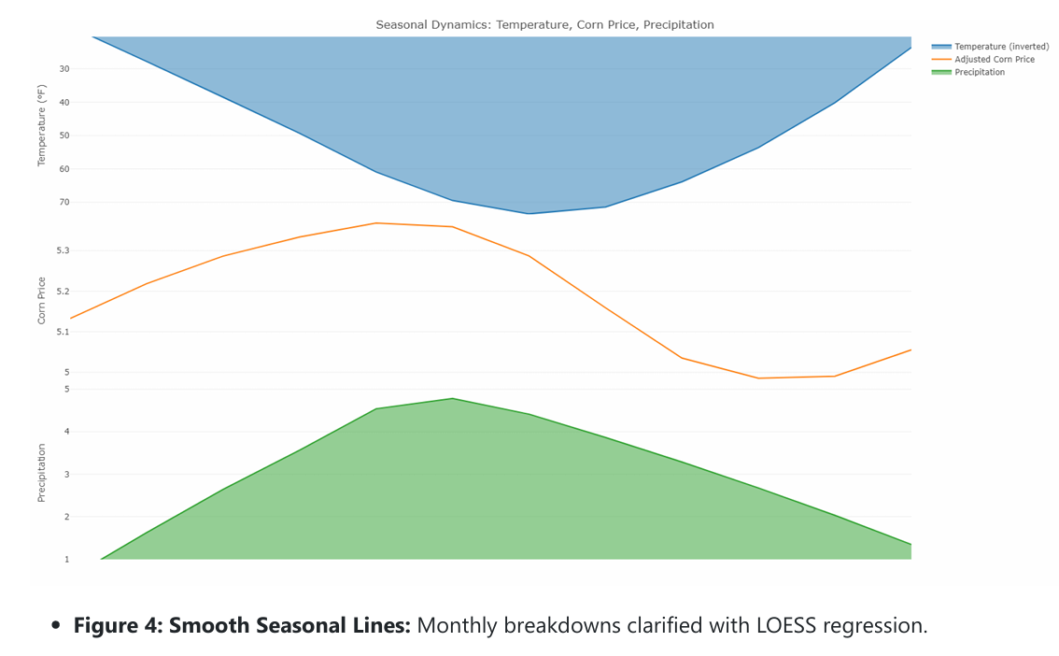

Slide 13
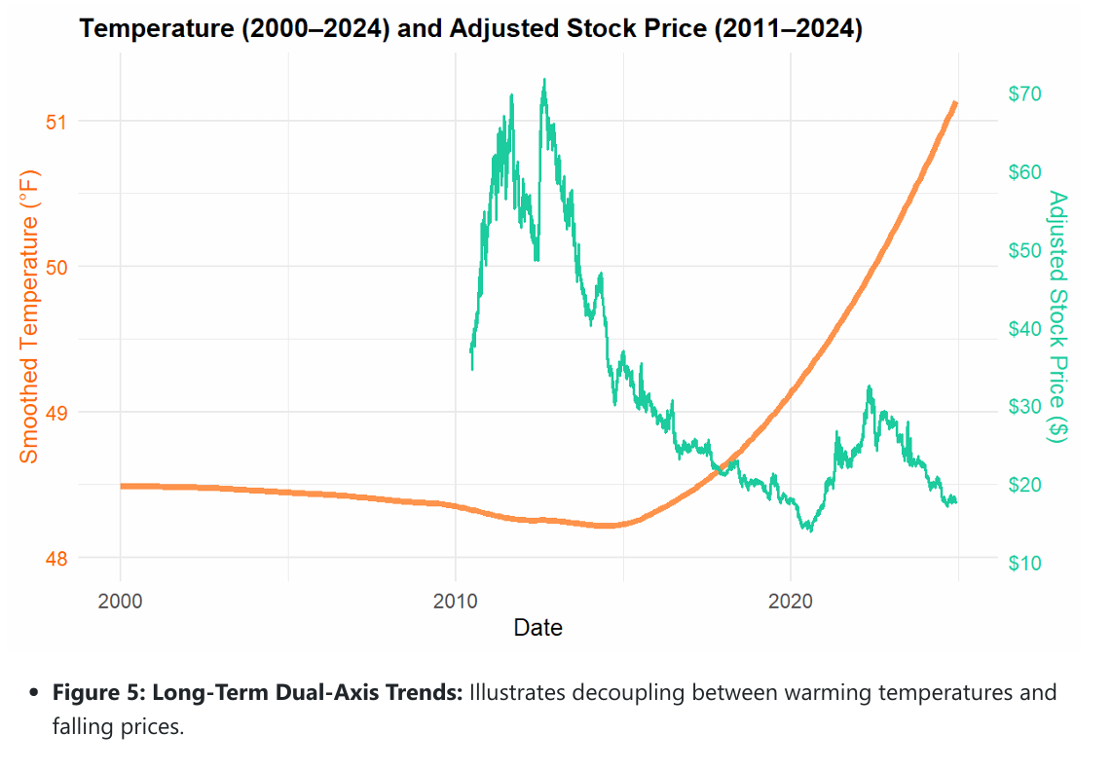

Slide 14
Key takeaways
Corn prices are most expensive in May and June, coinciding with plenty of rain and moderate temperatures.
When July and August heat dries up, prices decline one possible reason could be heat stress effect.
Rain appears to have a more straightforward effect on price fluctuation compared to temperature.

Slide 15
Thank You

